Slide 1


Zheyuan Hu
2023/3/14

Slide 2

Outline
Executive Summary
Introduction
Methodology
Results
Conclusion
Appendix

Slide 3
Executive Summary
Summary of methodologies
Data Collection (Web Scraping & API)​
Exploratory Data Analysis (Data Wrangling, Visualization, Dashboard)​
Predictive Analysis (Machine Learning)
Summary of all results
Successfully collected data from public sources​
Feature engineering and interactive dashboard​
Mathematical model evaluation and comparison

Slide 4
Introduction
Project background and context
Space X reused the first stage during Falcon 9 launches which saved large amount of expenses. By analyzing their spacecraft launching data, we want to obtain valuable insights about Space X launches and help another company Space Y to join the competition.
Problems you want to find answers
What are some key factors that lead to a successful landing?
How do these factors affect the success rate?

Slide 5

Section 1

Slide 6
Methodology
Executive Summary
Data collection methodology:
SpaceX API & Web Scraping
Perform data wrangling
Data Preprocessing & Data Categorization
Perform exploratory data analysis (EDA) using visualization and SQL
Perform interactive visual analytics using Folium and Plotly Dash
Perform predictive analysis using classification models
Normalization & Various Model Fitting & Parameter Hypertuning

Slide 7
Data Collection
Data was collected from Space X API (https://api.spacexdata.com/v4/rockets/)
Another data source was web-scraped from Wikipedia (https://en.wikipedia.org/wiki/List_of_Falcon/_9/_and_Falcon_Heavy_launches)

Slide 8
Data Collection – SpaceX API
Send request to API and get response
Load data into json format
Itemize the info from the data
Convert data to pandas dataframe
Filter dataframe and deal with missing values
Export to csv file
Link to code:
https://github.com/jouran/IBM-Data-Science-Capstone/blob/2b82f629e8a273e1c2466625869f713e94c808ed/jupyter-labs-spacex-data-collection-api.ipynb

Slide 9
Data Collection - Scraping
Request needed data from Wikipedia from its url
Extract variable names from HTML file
Parse HTML tables into a dataframe
Export to csv file
Link to code:
https://github.com/jouran/IBM-Data-Science-Capstone/blob/2b82f629e8a273e1c2466625869f713e94c808ed/jupyter-labs-webscraping.ipynb

Slide 10
Data Wrangling
Load the dataset into dataframe
Calculate # of launches on each site
Calculate # and occurrence of each orbit
Calculate occurrence of each outcome per orbit type
Create landing outcome label
Export to csv file
Link to code:
https://github.com/jouran/IBM-Data-Science-Capstone/blob/2b82f629e8a273e1c2466625869f713e94c808ed/IBM-DS0321EN-SkillsNetwork_labs_module_1_L3_labs-jupyter-spacex-data_wrangling_jupyterlite.jupyterlite.ipynb

Slide 11
EDA with Data Visualization
Scatter plots (Flight Number vs. Payload Mass, Flight Number vs. Launch Site, Payload Mass vs. Launch Site, Flight Number vs. Orbit Type, Payload Mass vs. Orbit Type) show relationship between two variables.
Bar chart (Orbit Type vs. Success Rate) shows comparison between multiple variables.
Line graph (Success Rate vs. Year) shows trend.
Link to code:
https://github.com/jouran/IBM-Data-Science-Capstone/blob/2b82f629e8a273e1c2466625869f713e94c808ed/IBM-DS0321EN-SkillsNetwork_labs_module_2_jupyter-labs-eda-dataviz.ipynb.jupyterlite.ipynb

Slide 12
EDA with SQL
Displaying the names of the unique launch sites in the space mission
Displaying 5 records where launch sites begin with the string ‘CCA’
Displaying the total payload mass carried by boosters launched by NASA (CRS)
Displaying average payload mass carried by booster version F9 v1.1
Listing the date when the first successful landing outcome in ground pad was achieved
Listing the names of the boosters which have success in drone ship and have payload mass greater than 4000 but less than 6000
Listing the total number of successful and failure mission outcomes
Listing the names of the booster versions which have carried the maximum payload mass
Listing the failed landing outcomes in drone ship, their booster versions and launch site names for the months in year 2015
Ranking the count of landing outcomes (such as Failure (drone ship) or Success (ground pad)) between the date 2010-06-04 and 2017-03-20 in descending order
Link to code:
https://github.com/jouran/IBM-Data-Science-Capstone/blob/2b82f629e8a273e1c2466625869f713e94c808ed/jupyter-labs-eda-sql-coursera_sqllite.ipynb

Slide 13
Build an Interactive Map with Folium
I added markers with Circle, Popup Label and Text Label of all Launch Sites based on their latitude and longitude coordinates to show their geographical location.
I added colored markers indicating success with green color and failure with red color.
I used Marker Cluster to display multiple launches for the same site.
I used markers to show distance between a selected launch site to a nearby coastline and a railway, and added a line between them along with the distance shown.
By creating and marking on the interactive map, we are able to get a better understanding of the dataset. Visualizing them gives us a geological inspiration regarding potential future launch outcomes.
Link to code:
https://github.com/jouran/IBM-Data-Science-Capstone/blob/2b82f629e8a273e1c2466625869f713e94c808ed/IBM-DS0321EN-SkillsNetwork_labs_module_3_lab_jupyter_launch_site_location.jupyterlite.ipynb

Slide 14
Build a Dashboard with Plotly Dash
Graph 1: Pie Chart showing percentage of launches by site, with a dropdown that allows user to choose launch site
Graph 2: Scatter Chart showing the relationship of successful outcome versus payload mass, with a slider that allows user to choose the range of payload mass.
This dashboard grants flexibility and user-friendliness in exploring the relationships between payload mass, launch sites, and successful outcome. It could assist users to experiment and discover what helps achieve a successful launch.
Link to code:
https://github.com/jouran/IBM-Data-Science-Capstone/blob/2b82f629e8a273e1c2466625869f713e94c808ed/spacex_dash_app.py

Slide 15
Predictive Analysis (Classification)
Data Preprocessing (Load data, normalize data, train test split)
Model Training (Logistic Reg, SVM, Decision Tree, KNN)
Parameter Tuning (GridSearchCV)
Model Evaluation (Accuracy on test dataset)
Model Comparison
Link to code:
https://github.com/jouran/IBM-Data-Science-Capstone/blob/2b82f629e8a273e1c2466625869f713e94c808ed/IBM-DS0321EN-SkillsNetwork_labs_module_4_SpaceX_Machine_Learning_Prediction_Part_5.jupyterlite.ipynb

Slide 16
Results
Exploratory data analysis results
Interactive analytics demo in screenshots
Predictive analysis results

Slide 17

Section 2

Slide 18
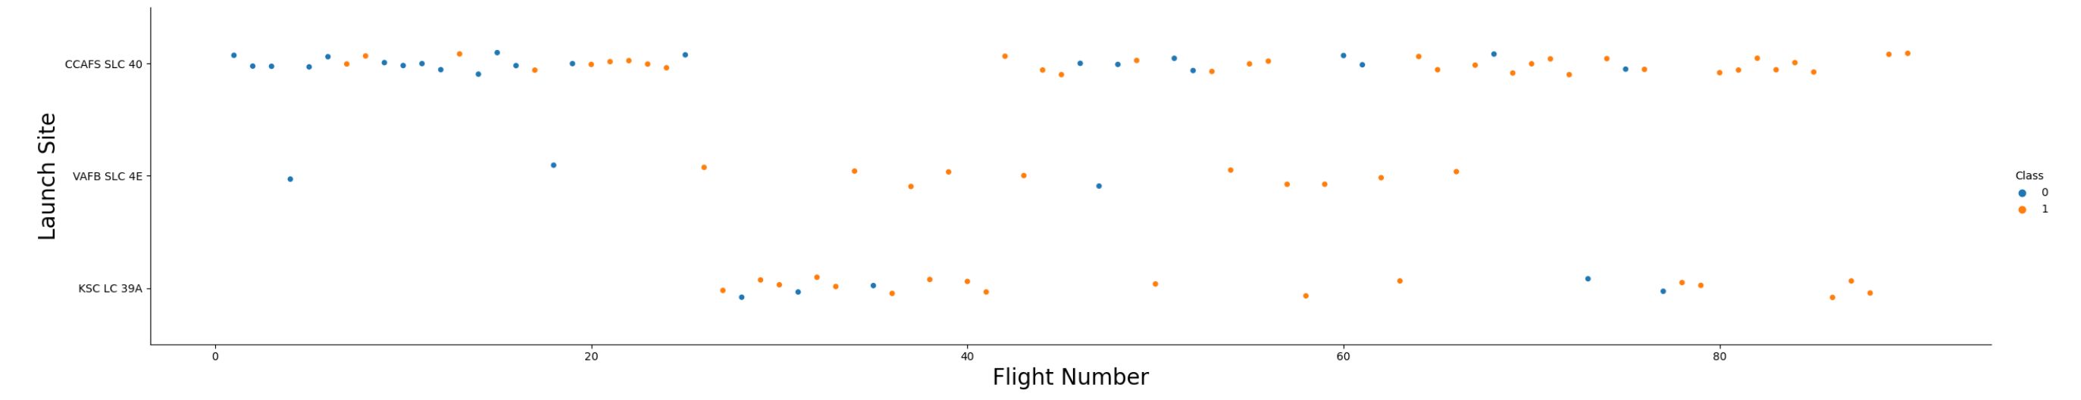
Flight Number vs. Launch Site
First couple flights all failed and last few flights are all successful
CCAFS SLC-40 site has way more flights than others
Flight success rate appears to be growing over time

Slide 19
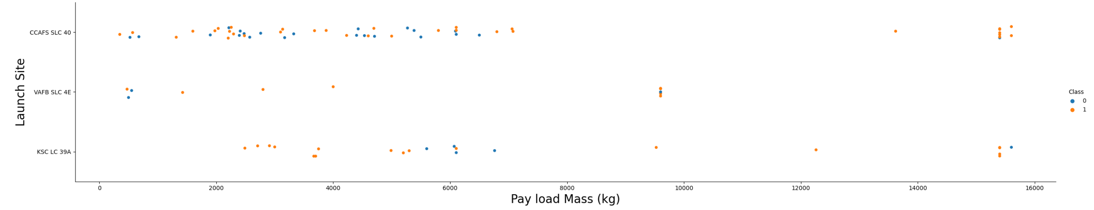
Payload vs. Launch Site
KSC LC-39A is more likely to succeed if payload is less than 5500 kg
For all sites, payload mass larger than 9000 kg will be more likely to succeed

Slide 20
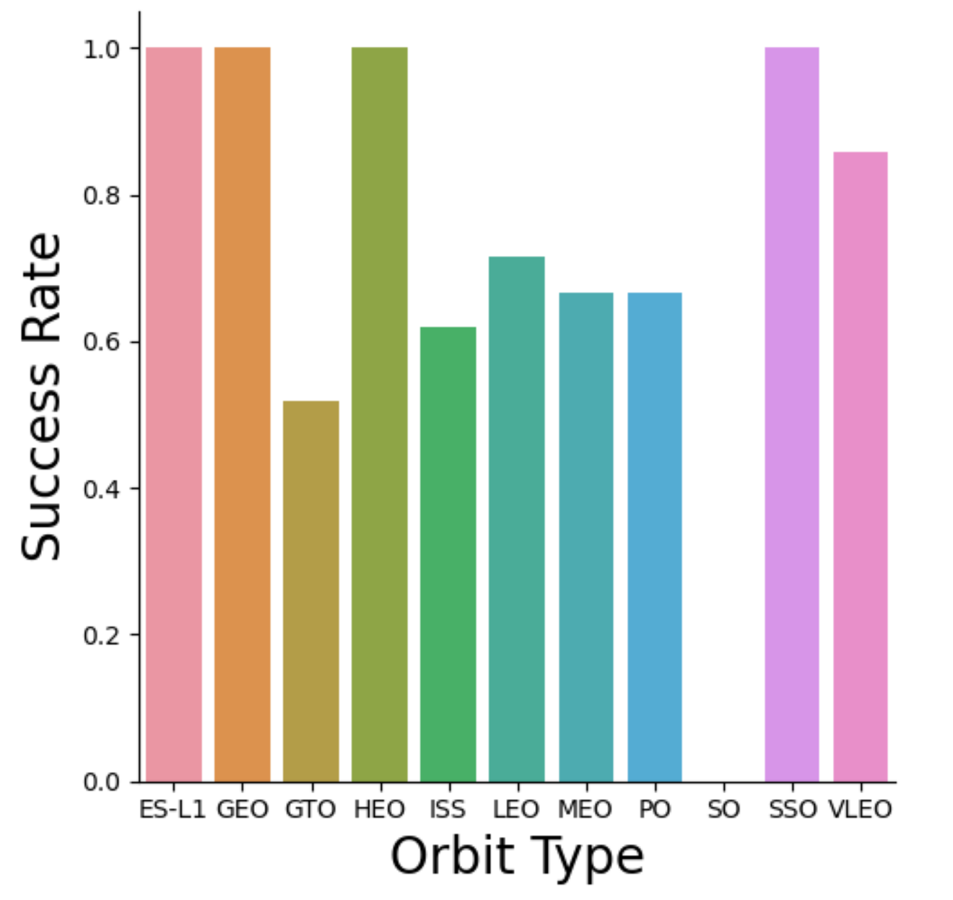
Success Rate vs. Orbit Type
ES-L1, GEO, HEO, SSO have 100% success rate
SO has 0% success rate
All other orbits have at least 50% success rate

Slide 21
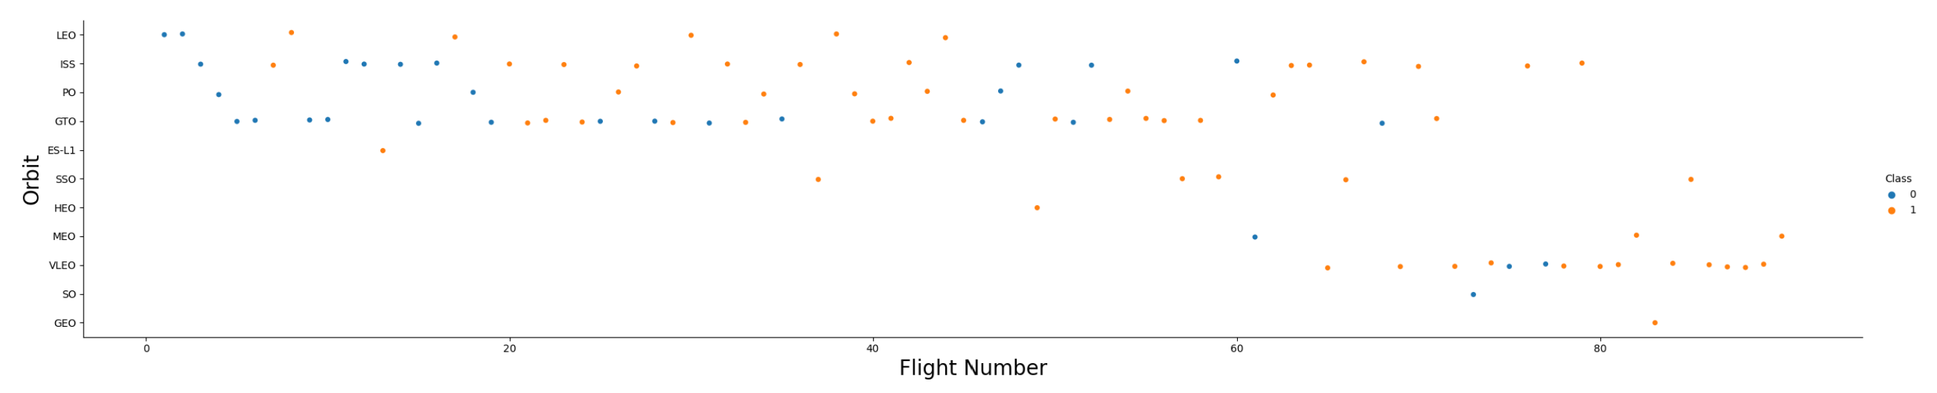
Flight Number vs. Orbit Type
It appears that the success rate increases over time for nearly all orbit

Slide 22
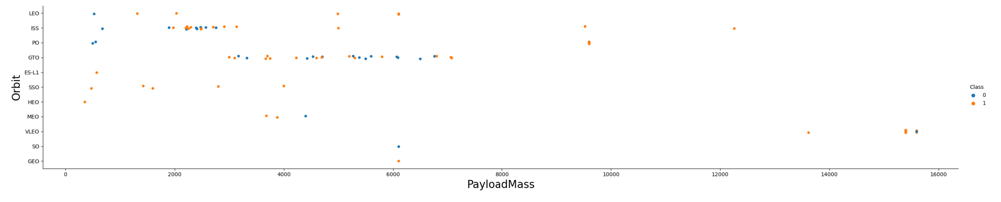
Payload vs. Orbit Type
If larger payload mass, LEO, ISS, and PO will be more likely to succeed
If smaller payload mass, SSO and MEO will be more likely to succeed

Slide 23
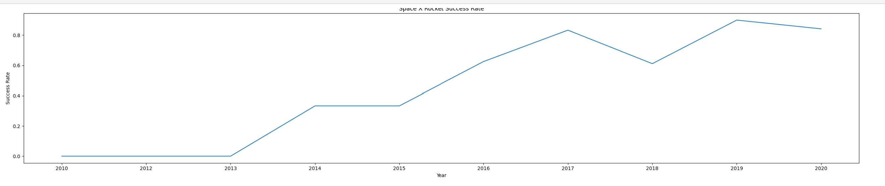
Launch Success Yearly Trend
The success rate started to increase since 2013
It can be predicted that the success rate will keep increasing in the long term

Slide 24
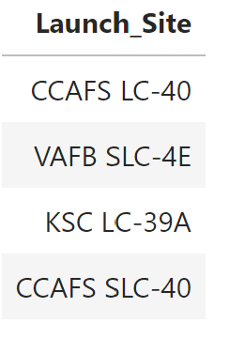
All Launch Site Names
Here is the query result showing 4 unique launch sites

Slide 25
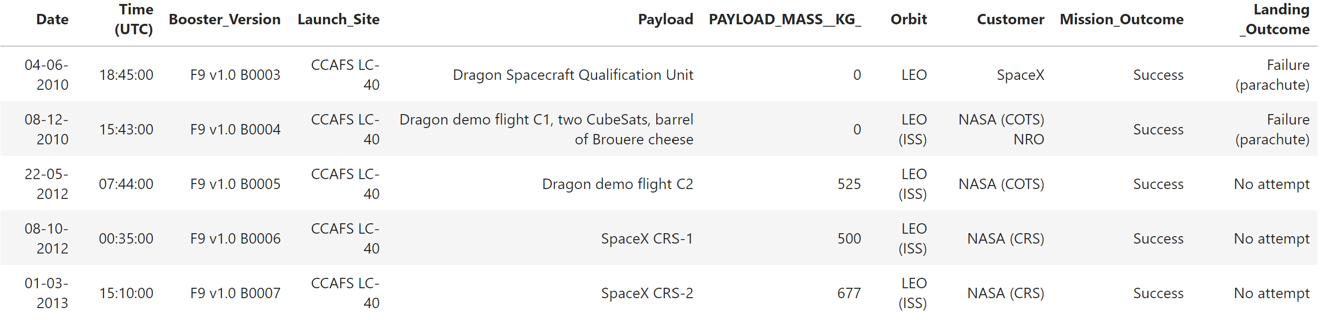
Launch Site Names Begin with 'CCA'
Here is the query result showing 5 records where launch site names begin with ‘CCA’

Slide 26
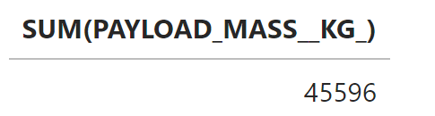
Total Payload Mass
Here is the query result showing the total payload mass is 45596 kg

Slide 27
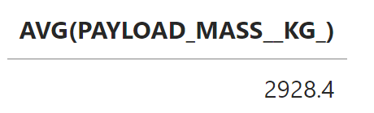
Average Payload Mass by F9 v1.1
Here is the query result showing the average payload mass by F9 v1.1 is 2928.4 kg

Slide 28
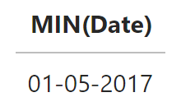
First Successful Ground Landing Date
Here is the query result showing the first successful ground landing date is 2017-1-5

Slide 29
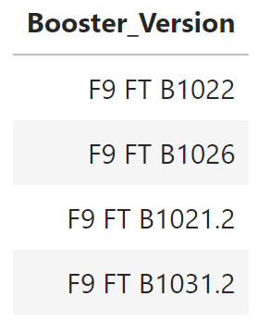
Successful Drone Ship Landing with Payload between 4000 and 6000
Here is the query result showing the booster version which have successful drone ship landing with payload between 4000 and 6000

Slide 30
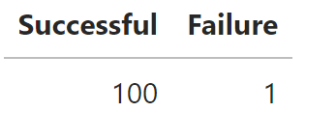
Total Number of Successful and Failure Mission Outcomes
Here is the query result showing the number of successful and failure outcomes

Slide 31
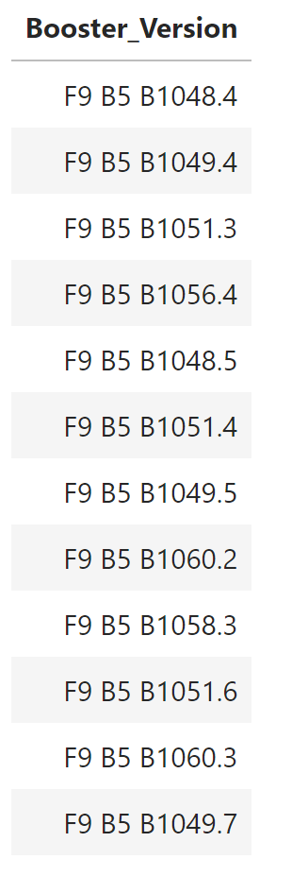
Boosters Carried Maximum Payload
Here is the query result showing the booster versions with maximum payload

Slide 32
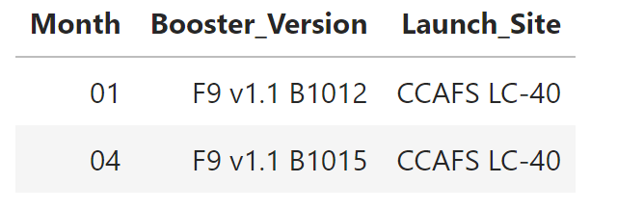
2015 Launch Records
Here is the query result showing launch records in 2015 where landing outcome is failure

Slide 33
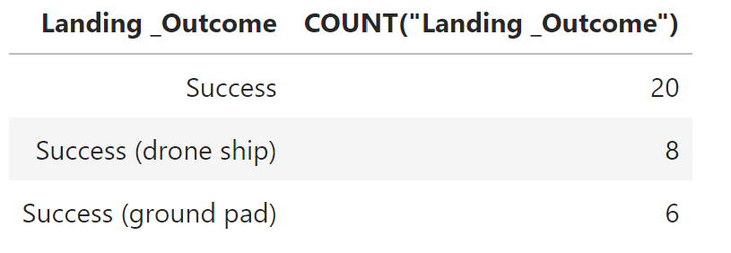
Rank Landing Outcomes Between 2010-06-04 and 2017-03-20
Here is the query result showing the ranking of landing outcomes between 2010-6-4 and 2017-3-20

Slide 34

Section 3

Slide 35
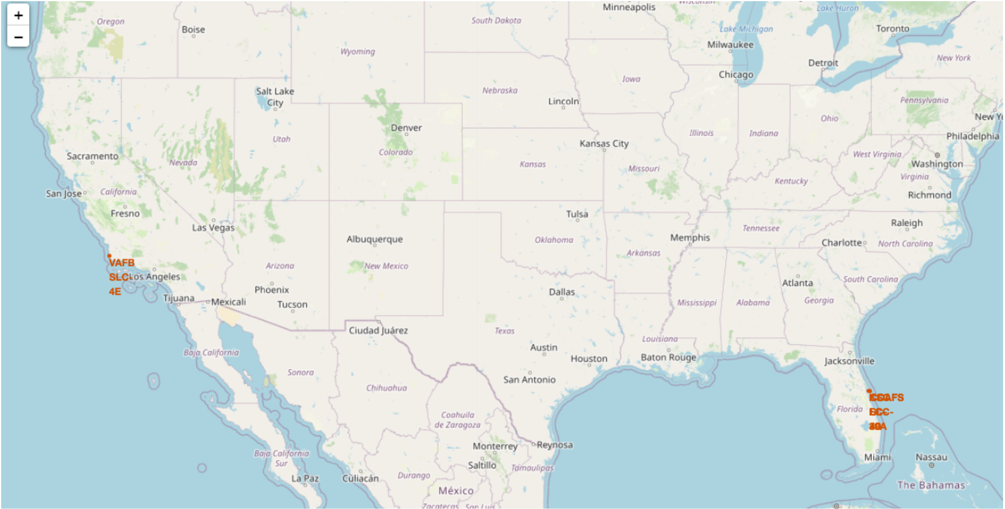
All Launch Sites
All launch sites are relatively close to a major city
All launch sites are near coastlines

Slide 36
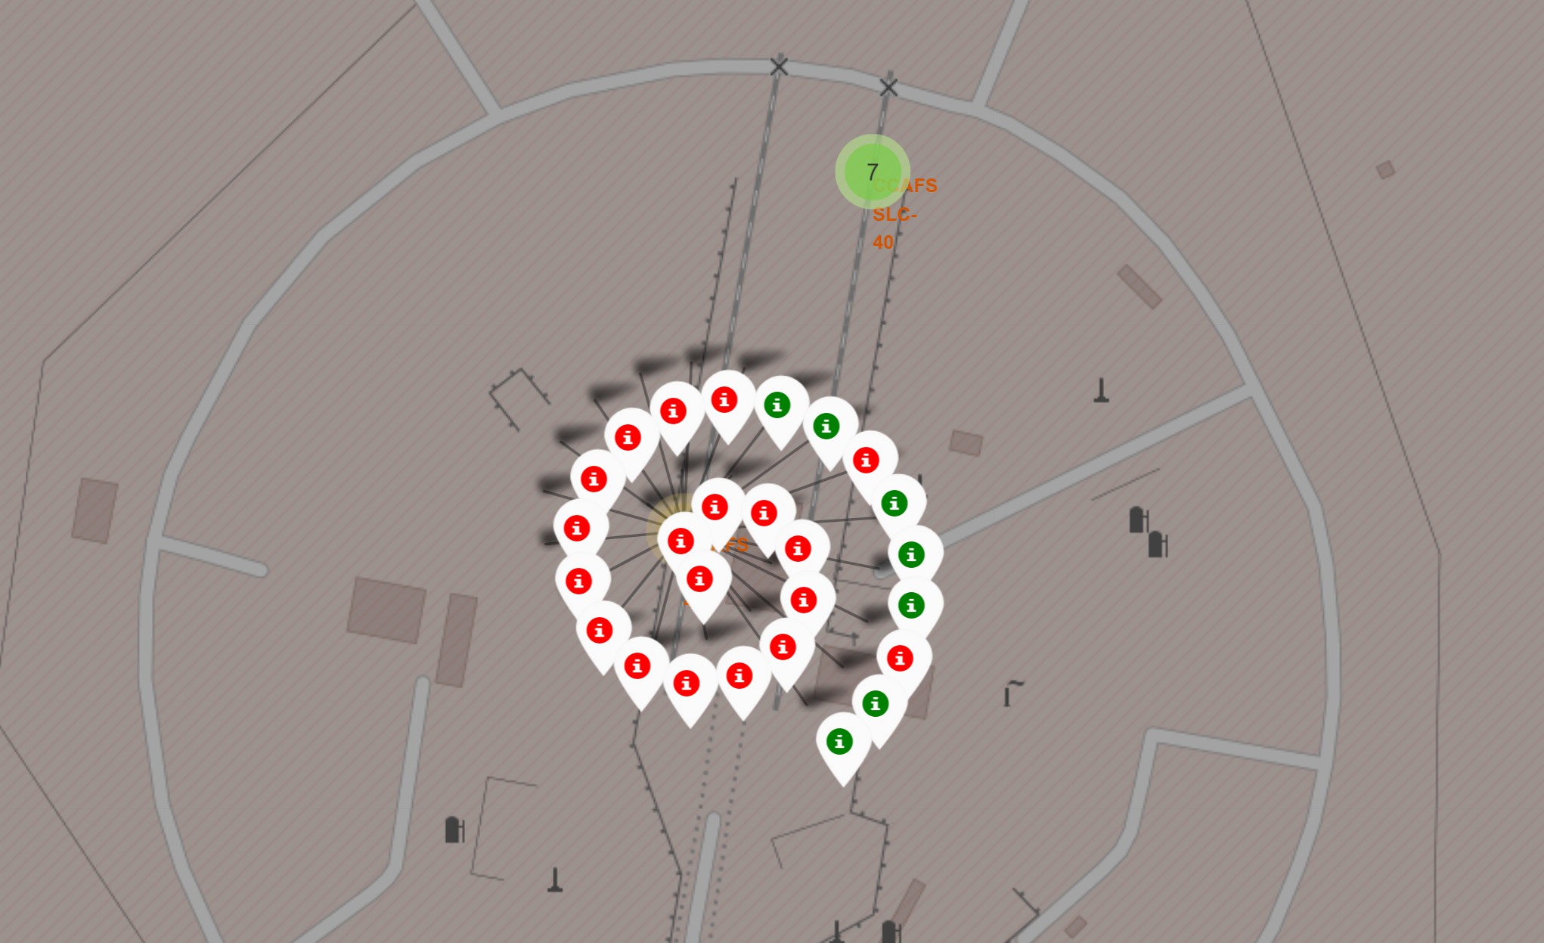
Color-labeled Launch Outcomes
Green marker indicates successful launch
Red marker indicates failed launch

Slide 37
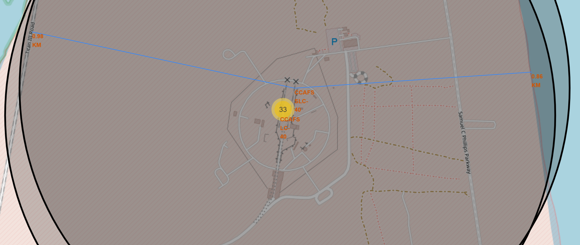
Proximities of Launch Sites
This site has logistics advantage due to being close to railroad, highway, and coastline
All launch sites are near coastlines

Slide 38

Section 4

Slide 39
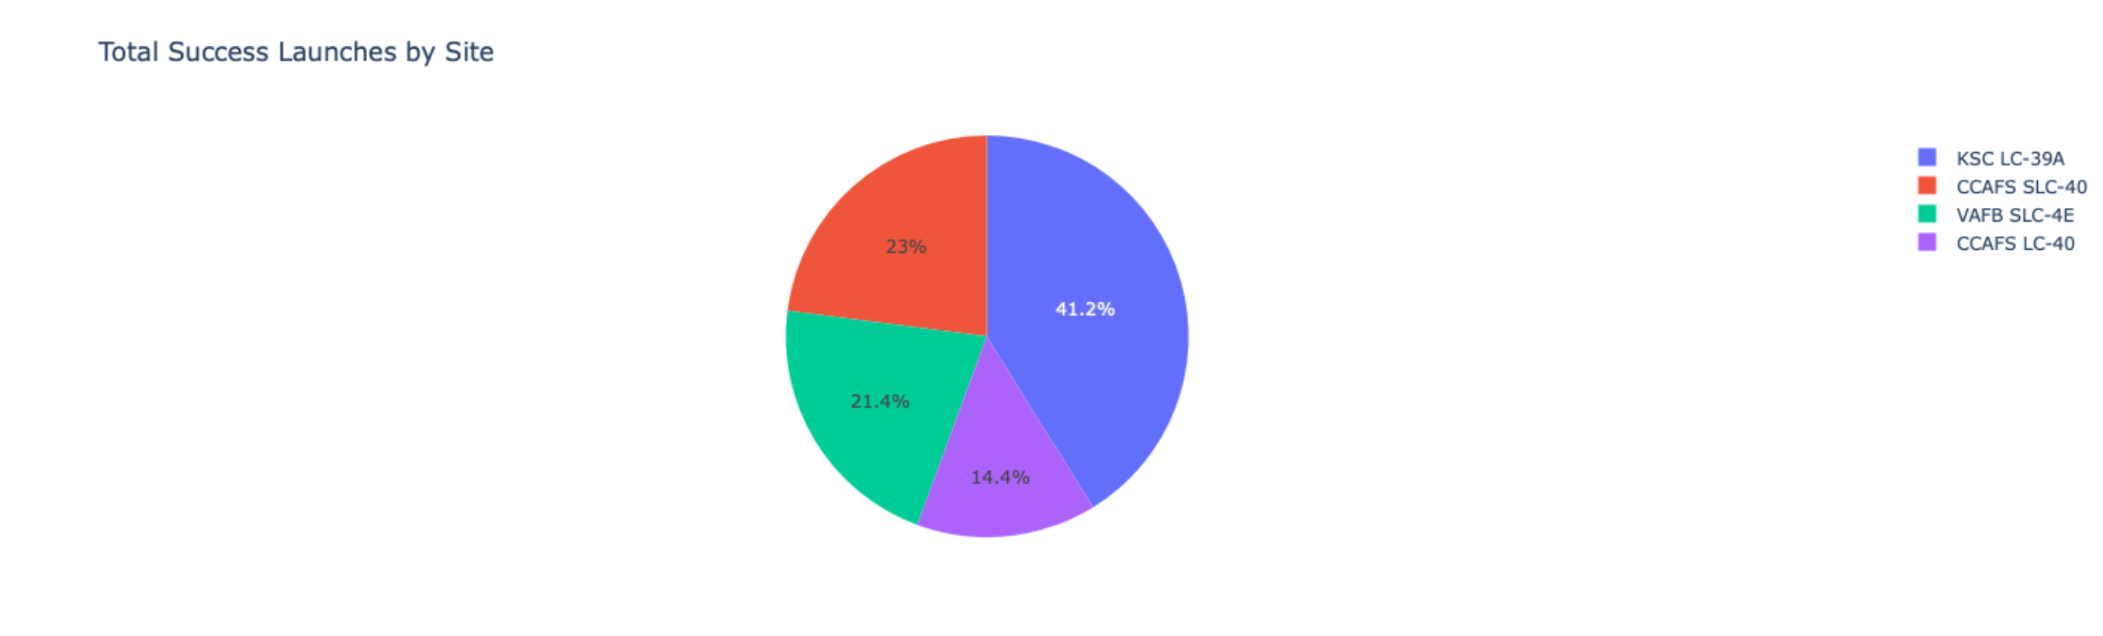
Total Success Launches for All Sites
KSC LC-39A has highest success launches
CCAFS LC-40 has lowest success launches

Slide 40
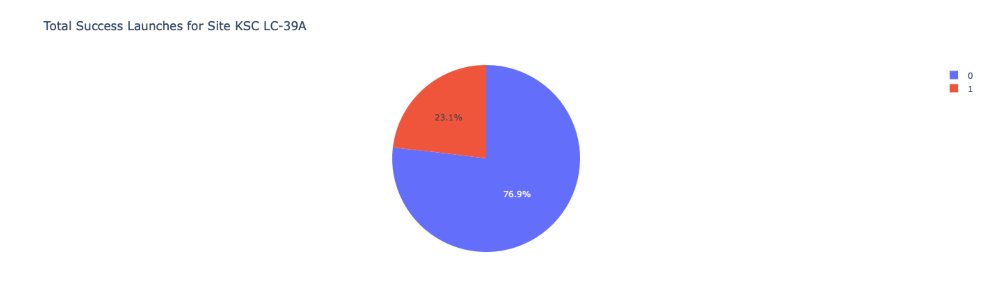
Launch Site with Highest Success Ratio
KSC LC-39A has over ¾ success rate which is quite high

Slide 41
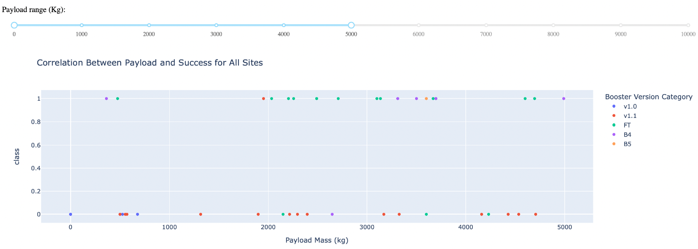
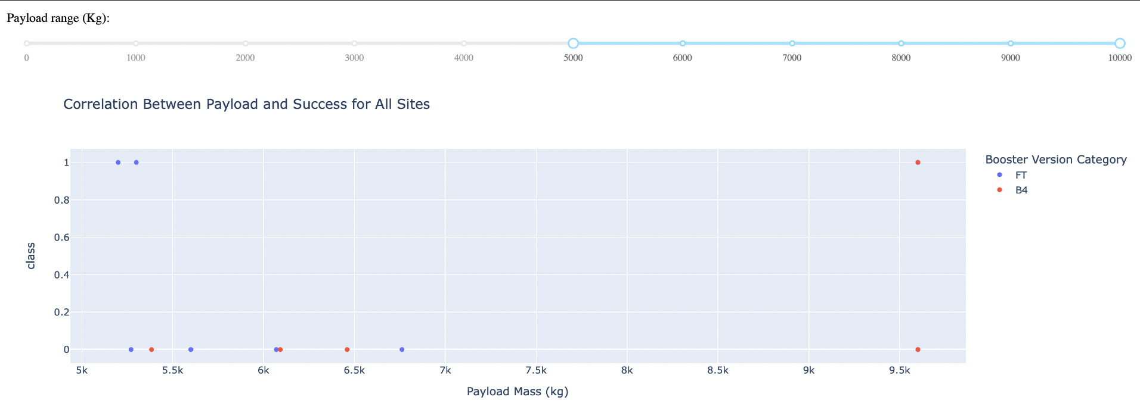
Payload vs. Launch Outcome Scatter Plot
Below 5000 kg, it is almost equally likely to succeed or fail
Over 5000 kg, it is more likely to fail

Slide 42

Section 5

Slide 43
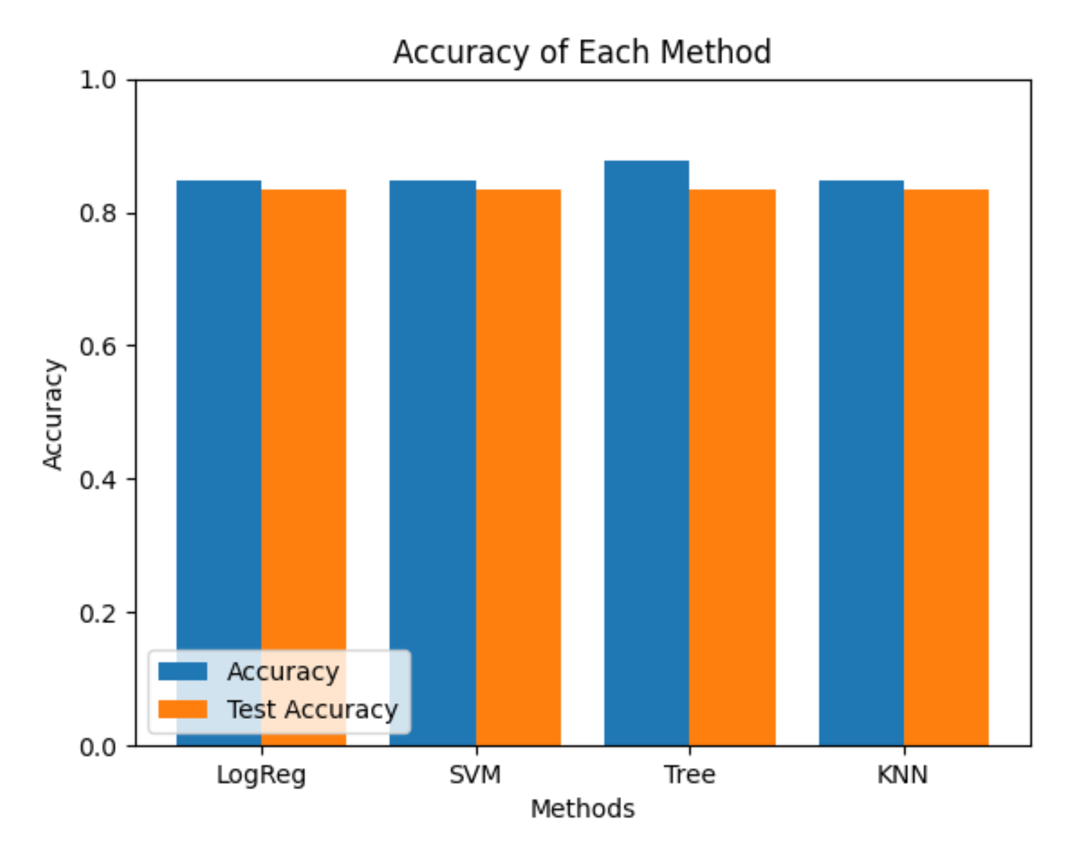
Classification Accuracy
Four models were trained and the train / test accuracy was displayed above
They all have the same test accuracy, possibly because the dataset sample size is too small
Decision Tree model has slightly higher training accuracy

Slide 44
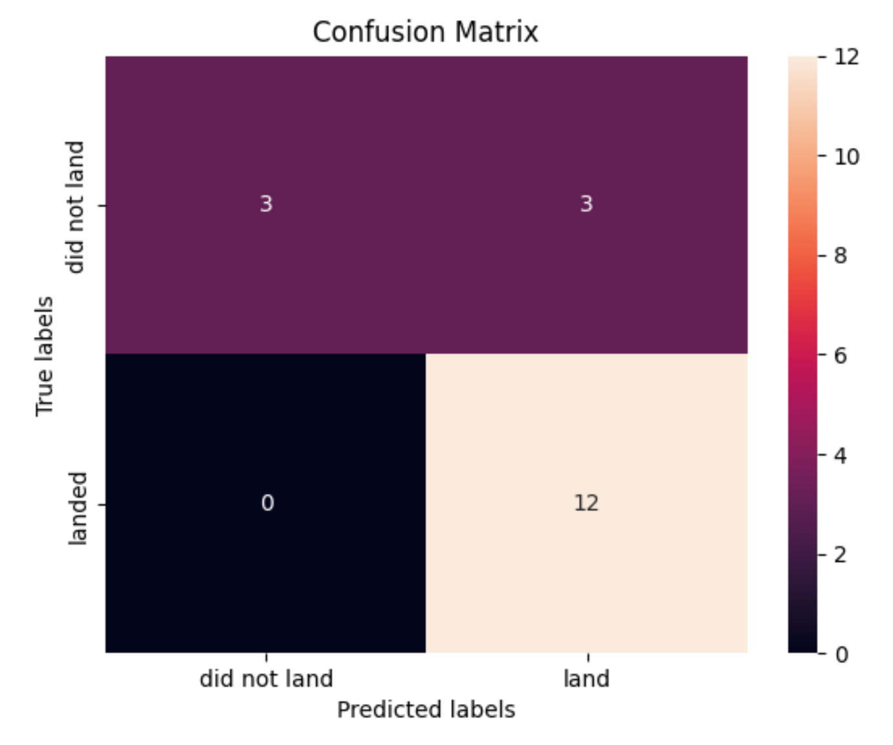
Confusion Matrix
This is the confusion matrix for Decision Tree model
The majority cases are true positives
The problem in this model is mainly in the cases of false positives

Slide 45
Conclusions
KSC LC-39A might be the best option among all launch sites
Launch sites with convenient logistics are preferred
Low payload mass is preferred
Success rate improves over the years
ES-L1, GEO, HEO, SSO orbits are preferred
For future analysis, decision tree might be preferred

Slide 46
Appendix
Special thanks to IBM, Coursera, instructors, and peers who help review my work

Slide 47


